Slide 1
Creating Automated Projects In Azure DevOps
Aleeta Davis
166743

Slide 2
Steps
Log in to dev.azure.com and get an Azure subscription.
Create an organization using your credentials.
Get into that organization page and click on new project.
Create a new project by selecting required data for public/private project as we wish.Under advanced tab we can select version control as well as work items according to our requirement.
Click create and project will be created .
If you want to edit or add or remove any users, or want to modify the project settings,in the bottom left corner there is project settings.
If you want to delete your project, project settings -> Delete.

Slide 3
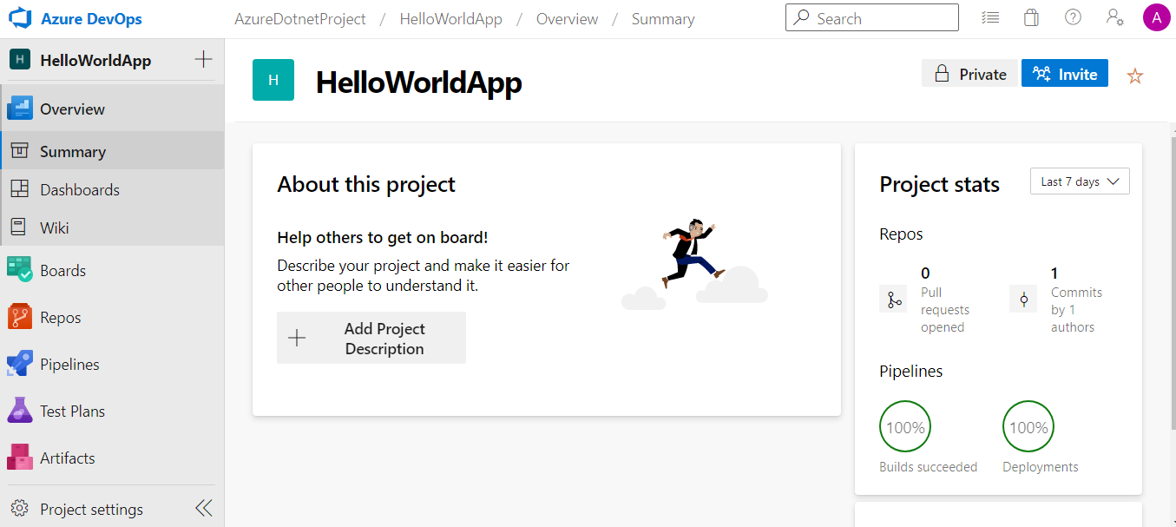

Slide 4
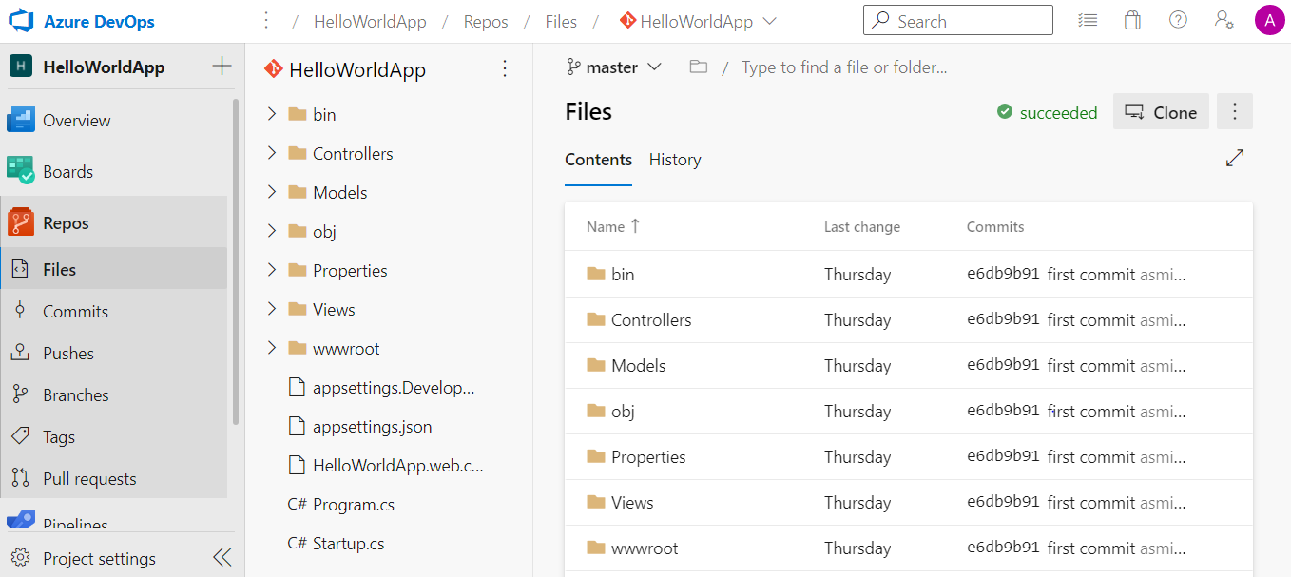
Files can added and commited to Repos in Azure DevOps from our local system

Slide 5
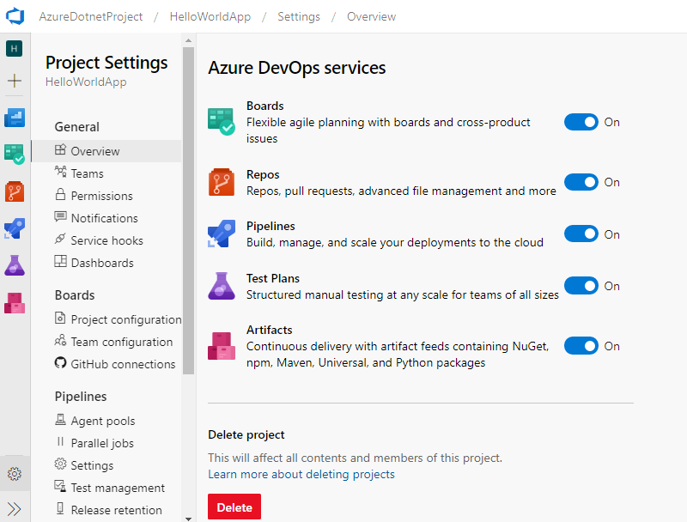
Project settings

Slide 6
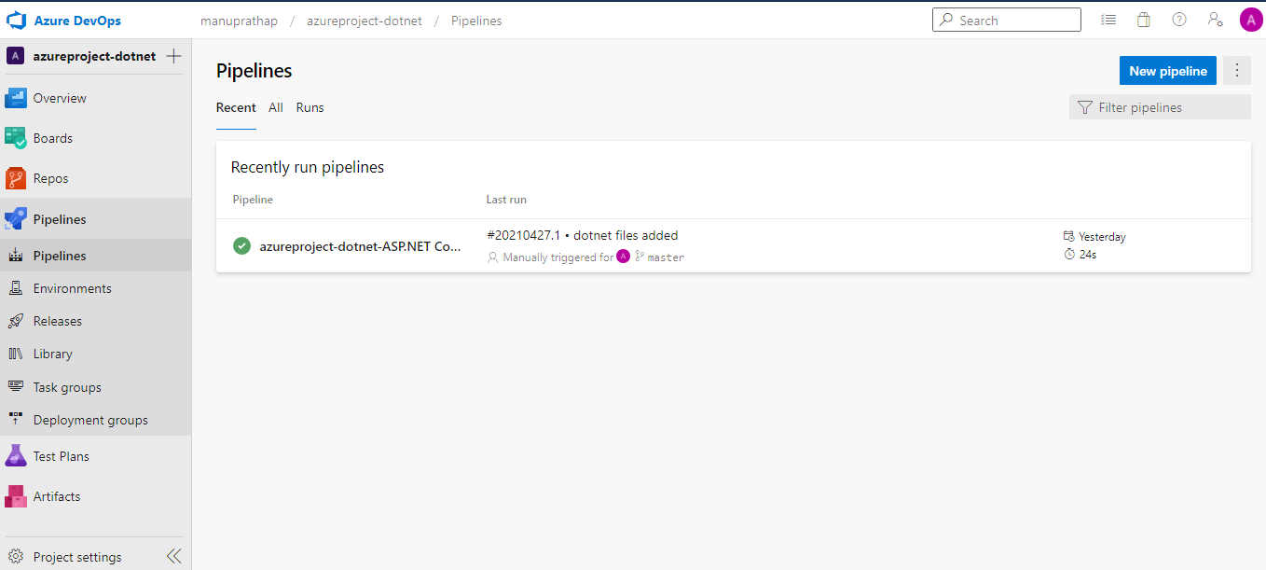
New Pipelines CI CD created here

Slide 7
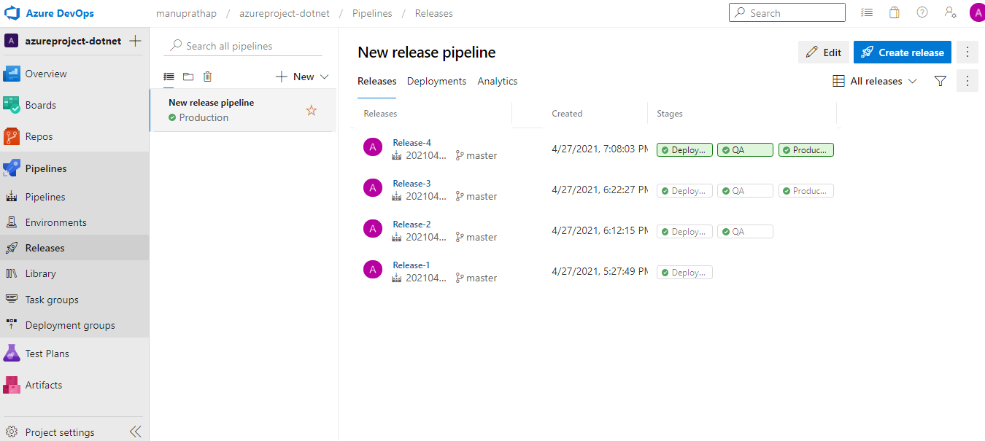
New pipeline releses created here.

Slide 8
THANK YOU

